Slide 1
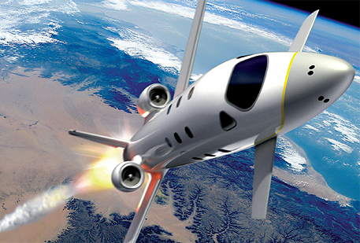

FDIR Spacecraft fault protection system
Project 1
Euro Team
Alauzet Pierre, Ahvenniemi Mikko,
Colin Julien, Starck Benoit
CS554 - Design for Software & Systems

Slide 2
Table of Contents
Problem understanding
Functional requirements (use-case model)
Non-functional requirements
Usability analysis & design

Slide 3
1. Problem understanding
Business purpose & problem frames
Problem understanding
Functional requirements (use-case model)
Non-functional requirements
Usability analysis & design

Slide 4
Business purpose

Slide 5
System requirements

Slide 6
Problem frames
Context Diagram :
Crew
Ground Control
Systems
FDIR
Report
Information Display
FDIR Storage System

Slide 7
Problem frames (cont.)
Problem diagram 1/3: Information Retrieval
FDIR Storage System
a
c
FDIR
Retrieve information
b
Crew/ Ground Control
d
c:FDIR! {query}
FDIR SS! {return data}
a: FDIR SS!{status data}
b:Crew!{search}
FDIR!{display}
d: Crew!{search}
Commanded behaviour problem frame

Slide 8
Problem frames (cont.)
Problem diagram 2/3: Providing Failure Localization
FDIR Storage System
a
d
FDIR
Locate system failure
c
b
Report
c: FDIR! {write failure location, write type of failure}
b: Report! {failure data}
d: FDIR Storage System! {send device, send value}
a: FDIR Storage System! {device, value, time}
Transformation problem frame

Slide 9
Problem frames (cont.)
Problem diagram 3/3: Response in case of unresolvable conditions
FDIR Storage System
a
d
FDIR
Notify crew about unresolvable conditions
c
b
Report
c: FDIR! {write notification, write unresolvable conditions}
b: Report! {notification}
d: FDIR Storage System! {send device, send value}
a: FDIR Storage System! {device, value, time}
Transformation problem frame

Slide 10
Problem frames (cont.)
Conclusion:
New aspects of requirements were emphasized using problem frames.
Necessity of:
clearly defining which domains interact with the machine
considering both data storage, processing and display
considering errors and exceptions in interactions

Slide 11
2. Functional requirements
Use-case & sequences diagrams
Problem understanding
Functional requirements (use-case model)
Non-functional requirements
Usability analysis & design

Slide 12
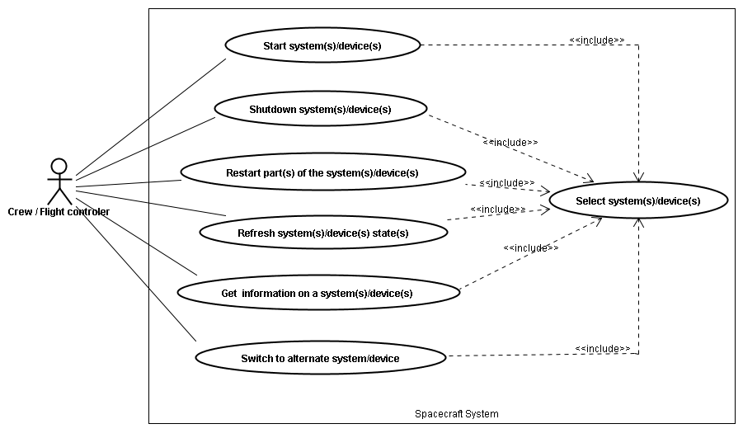
Use case diagram

Slide 13
Sequence diagrams

Slide 14
Sequence diagrams (cont.)

Slide 15
3. Non-functional requirements
Identified & improvised quality attributes
Problem understanding
Functional requirements (use-case model)
Non-functional requirements
Usability analysis & design

Slide 16
Identified attributes

Slide 17
Improvised attributes

Slide 18
4. Usability analysis & design
Protoypes & usability scenarios discussions
Problem understanding
Functional requirements (use-case model)
Non-functional requirements
Usability analysis & design

Slide 19
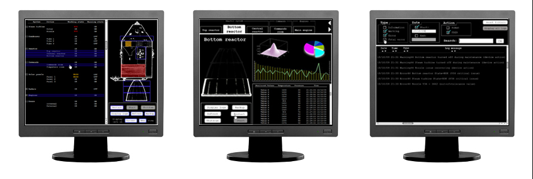
User interface design
Screen 1
System List
Screen 2
System Information
Screen 3
Logs

Slide 20
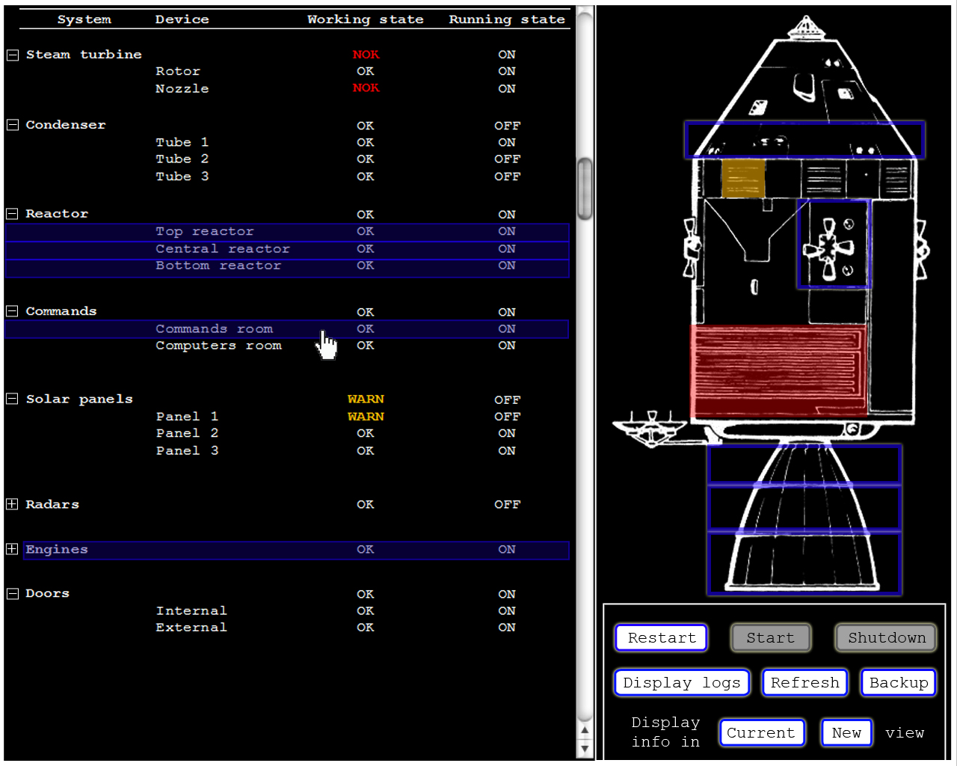

Slide 21
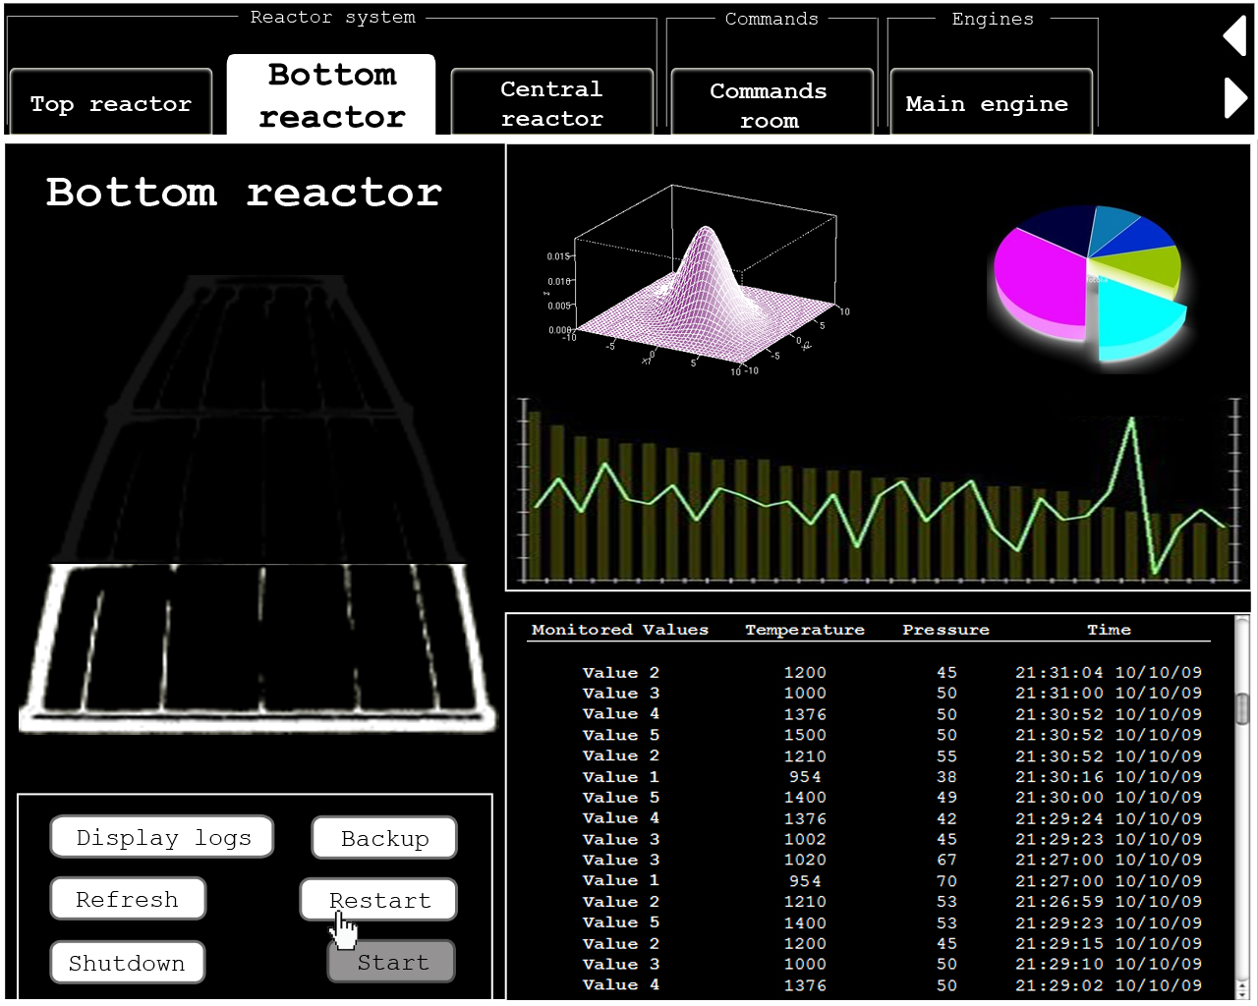

Slide 22
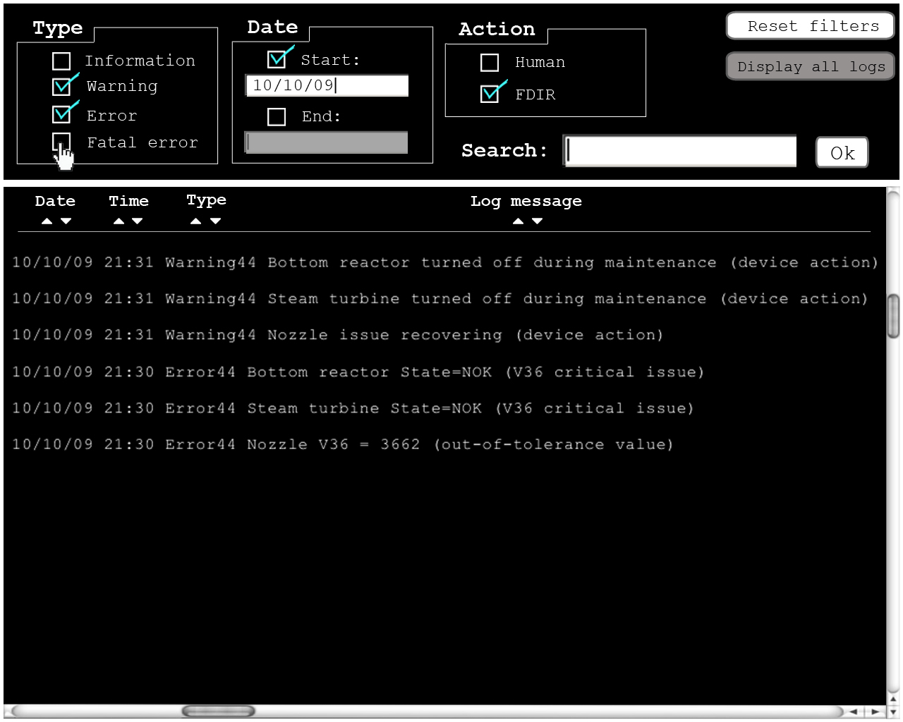

Slide 23
Usability scenarios discussions

Slide 24
conclusion
Problem frames provides us a new perspective around analysis
Problem frames technique provides patterns that allows us to identify each decomposed problem as a singular problem belonging to a standardized type
UML design
Problem frames
Solutions to bring to system’s requirements
Understand the underlying problems before considering any specification

Slide 25
FDIR Spacecraft fault protection system
Project 1
Euro Team
Alauzet Pierre, Ahvenniemi Mikko,
Colin Julien, Starck Benoit
CS554 - Design for Software & Systems

Slide 26
references
[Eas98] Steve Easterbrook, and et al., Experiences Using Lightweight Formal Methods for Requirements Modeling” IEEE Transactions on Software Engineering, Vol. 24, No. 1, January 1998.
[Jac05] Michael Jackson, Problem frames and software engineering, Information and Software Technology, Special Issue: 1st Int Workshop on Advances and Applications of Problem Frames, K. Cox, et al. eds, Vol. 47 No. 14, pp. 903-912, Nov. 2005.
http://www.bredemeyer.com/pdf_files/NonFunctReq.PDF, about non-function requirements

